Slide 1
Chapter 2: System Components
Principle of Network & System Administrator

Slide 2
What is systems
System refer to both to operating system of computer, collectively the set of computers that cooperate in a network
Def 1 : human – computer system : an organized collaboration between human and computer to solve a problem or provide a service.
Term operating systems has no rigorously accepted definition. Its often thought of as the collection of all programs bundled with a computer, combining kernel of basic services and utilities for users

Slide 3
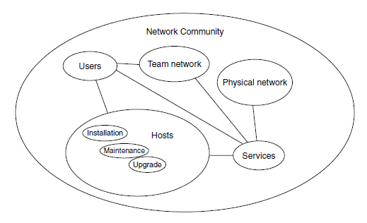
Network Infrastructure
Figure 2.1 : some of key dependencies in system administration

Slide 4
Network Infrastructure
Three main component in human – computer system
Human : who use and run the fixed infrastructure and cause most problems
Host computers : computer device that run software either in fixed or mobile location.
Network hardware : cover a variety of specialized device including the key component :
  Dedicated computing device that direct traffic around the internet. Routers talk at the IP address level or layer 3 .
  Switches: fixed hardware devices that direct traffic around local area network. Switches talk at the level ethernet or layer 2 protocols.
  Cables : There are many type of cable that interconnect device: fiber optic, twisted pair, null modem cables, and etc

Slide 5
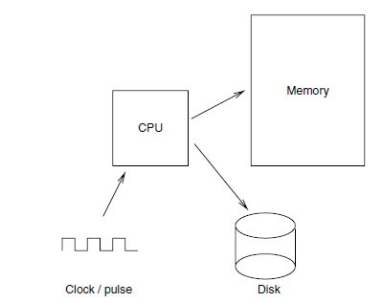
Computers
Figure 2.2: The basic elements of the von Neumann architecture

Slide 6
Computers
Each computer have :
  Clock – derive a CPU
  RAM
  Array of other devices
To work all this together :
  CPU is design to run program – read/write to h/ware devices.
  OS – more important
  Software layer provide working abstractions for programmers and users and consist of files, process and services.
  Network is refer to part of the system that carry message from one node to another by using wired/wireless.
  All this part and level are working together (system).

Slide 7
Handling Hardware
Electronic equipment should be treated as highly fragile and easy damaged.
Far too blase towards electronic equipment.
  Never insert / remove power without ensuring that its switch off
  Take care when inserting the multi pin
More :
Read instruction : when dealing either h/ware or s/ware, always look and read the instruction manual.
Interface and connector :………
Handling components :
DISK :
Memory :
Another expected – environment & wheather
  Lightening
  Power
  Heat
  Cold
  Humidity.

Slide 8
Operating System
Three (3) element
  Technical layer of software for driving the hardware
  A files systems
  Simple user interface
Type of OS:
  MS / PCC DOCS
  Windows 3x
  Mac OS
  Windows 95,98,ME
  AmigalDOS
  Unix-like
  VMS

Slide 9
Operating System
Type of OS
  NT-like
  Windows 2000 / XP
  OS390 (zOS)

Slide 10
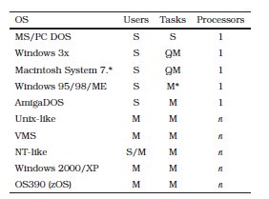
Operating System

Slide 11
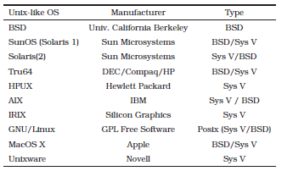
Operating System

Slide 12
Operating System
Multi user
  Allow multiple user to share resources of single host.
  Necessary to protect users from one another by giving
The legacy of insecure operating systems
  Mostly home computer operating system did not address security issue.
  Mac OS, DOS, Windows, AmigaDOS – nit completely in secure : no limits on what a determined user can do.
Securable operating systems
  To distinguish them from insecure OS, we shall refer to OS like Unix and NT as securable OS.
  Main reason why DOS and Windows 9X and Macintosh are so susceptible to virus attack – user can change the OS files.
  To restrict access to the system , it required a notion of ownership and permission.

Slide 13
Operating System
Shell or command interpreters
  Today most of OS provide the GUI for all kinds of task.
  Windows proprietary shells are rudimentary
  Unix shells are rich in complexity and some of them are available installation on Windows
  Shells can be used to write simple programs called scripts or batch files which often simply repetitive adminstrative task.
Log & audits
  OS kernels share resources and offer services,
  Can keep list of transactions which have taken place so that one can later go back and see we exactly happened at given time.
  Auditing became issue again in connection with security. Organization become afraid of break – ins from system cracker and want to able to trace activities of the system in orderbe able to look back and find out the identity of cracker.

Slide 14
Operating System
  Some organization , auditing are important. – one use for auditing is so called non repudiation or non –denial (a security feature which encourage users to be responsible for their actions).
Priviledged Accounts
  OS that restrict user privileges need an acc. Which can be use to configure and maintain the system
  For Unix, root acc is the privileged acc, its also refered to colloquially as the super user.
  For Windows, privilege acc is a Administrator, this acc don’t have automatic access to everything.
  Administrator & root accounts should never ve used for normal work – too much power.
  Use privilege acc as normal user would be to make system as insecure.

Slide 15
Operating System
Comparing Unix-Like and Windows computers
  Most popular classes of operating systems today
  File and directory structure Unix and Windows are different but both have same basic element.
  Unix-like OS are many varied – basic similar in concept
  Windows has adopted much from unix cultural heritage – eg: renaming \ and / in filename, changing the file name of some commands and etc
  Windows NT, 2000, XP are multi tasking OS from Microsoft which allow user to log in to a console or workstation
  the console may be joined together in a network with common resources shared by an NT domain.
  Windows did not have a remote shell login feature like Unix at the outset.
  One may now obtain a terminal server which gives Windows telnet-like functionality.

Slide 16
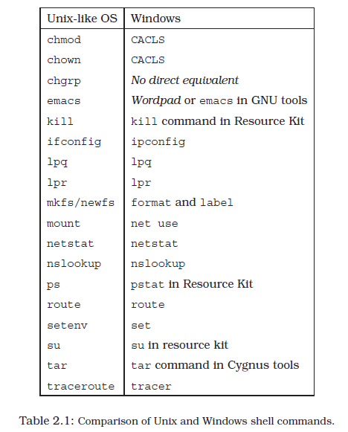
Operating System

Slide 17
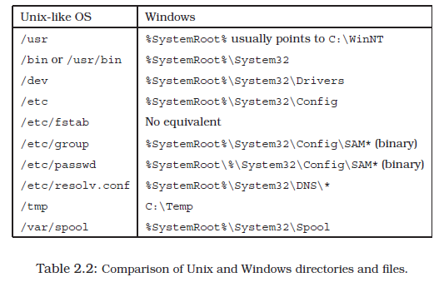
Operating System

Slide 18
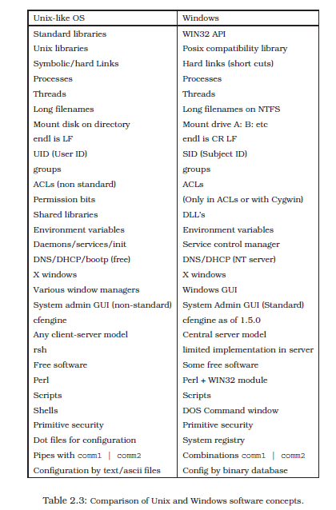
Operating System

Slide 19
Operating System
Filesystems
  File and filesystems are at the very heart of what system administration about.
  Every task in host administration or network configuration involves making changes to files
  Need to acquire a basic understand of the principles of systems
  For instance, fact that old filesystems were only 32 bit addressable and therefore supported a maximum partition size of 2GB or 4GB
  Newer filesystems are 64bit addressable and therefore have essentially no storage limits.
  Unix use an index node system of block addressing, Dos use tabular lookup system.

Slide 20
Operating System
Unix
  Has a hierarchical filesystems – make use directories and subdirectories to form a tree.
  All filesystems based on index nodes or inodes
  Every file has index entry stored in a special part of the filesystems.
  Inode contain extensible system of pointers to the actual disk block- associated with the file
  Inode also contains essential information needed to located a file on the disk.
  Start of the Unix file tree is call root filesystems or ‘/’.

Slide 21
Operating System
The file hierarchy
  /bin – execute binary program
  /etc – Miscellaneous programs configuration files
  /usr – this contain main meat of unix
  /usr/bin – more executables from the OS
  /usr/sbin – executables that are mainly interest to system administrator
  /usr/local – user’s custom software added
  /sys – hold configuration data
  /export – network server use only
  /dev or /device –a place where all logical device are collected.
  /home – user on some systems.
  /root – home for root
  /var – mixed file

Slide 22
Operating System
Symbolic links
  A pointer or an alias to another file
  Command : ln –s from file /other/directory/tolink
Hard links
  A duplicate directory reference to inode in the filesystem.
File access control
  To restrict privileges file on the system.
  Example of permisssion : type owner group anyone.
For example, the permission
Type Owner Group Anyone
  d rwx r-x ---

Slide 23
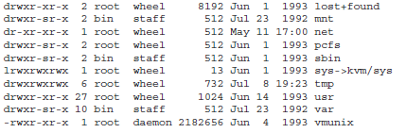
Operating System

Slide 24
Operating System
First column is textual representation of the representation of bits for each file.
Second column is the number of hard links to the file
Third and fourth column are the user name and group name
The remainder show the file size in bytes and the creation date.
There 16 protection bits for unix file but only 12 of them can be change by user.

Slide 25
Operating System
Here are some examples of the relationship between binary, octal and the
textual representation of file modes.
Binary Octal Text
  001 1 --x
  010 2 -w-
  100 4 r--
  110 6 rw-
  101 5 r-x
  - 644 rw-r--r--

Slide 26
Operating System
chmod
The chmod command changes the permission or mode of a file. Only the owner of the file or the superuser can change the permission.
# make write-able for everyone
  chmod a+w myfile
# add the user (owner) ’execute’ flag for directory
  chmod u+x mydir/
# open all files for everyone
  chmod 755 *
# set the s-bit on my-dir’s group
  chmod g+s mydir/
# descend recursively into directory opening all files
  chmod -R a+r dir

Slide 27
Operating System
New file objects: umask
When a new file is created, the operating system must decide what default protection bits to set on that file. The variable umask decides this. umask is normally set by each user in his or her .cshrc file (see next chapter).
umask 077 # safe
umask 022 # liberal
umask only removes bits, it never sets bits which were not already set in 666. For instance umask Permission
  077 600 (plain)
  077 700 (dir)
  022 644 (plain)
  022 755 (dir)

Slide 28
Operating System
Making programs executable
A Unix program is normally executed by typing its pathname. If the x execute bit is not set on the file, this will generate a ‘permission denied’ error. This protects the system from interpreting nonsense files as programs.
To make a program executable for someone, you must therefore ensure that they can execute the file, using a command like
  chmod u+x filename
This command would set execute permissions for the owner of the file; chmod ug+x filename would set execute permissions for the owner and for any users in the same group as the file. Note that script programs must also be readable in order to be executable, since the shell has to interpret them by reading.

Slide 29
Operating System
chown and chgrp
These two commands change the ownership and the group ownership of a file.
  chown mark ~mark/testfile
  chgrp www ~mark/www/tmp/cgi.out
In newer implementations of chown, we can change both owner and group attributes simultaneously, by using a dot notation:
  chown mark.www ~mark/www/tmp/cgi.out

Slide 30
Operating System
Making a group
The superuser creates groups by editing the file /etc/group. Normally users other than root cannot define their own groups.
This is a historical weakness in Unix, and one which no one seems to be in a hurry to change. It is possible to ‘hack’ a solution to this which allows users to create their own groups. The format of the group file is:
  group-name:: group-number: comma-separated-list-of-users

Slide 31
Operating System
ACLs, or access control lists are a modern replacement for file modes and permissions.
With access control lists we can specify precisely the access rights to files for each user individually.
ACLs are literally lists of access rights. Each file has a list of data structures with pairs of names and permissions:

Slide 32
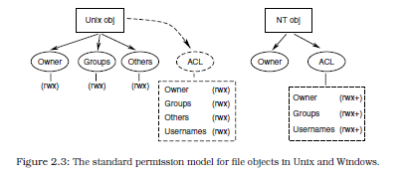
Operating System

Slide 33
Operating System
the commands to read and write ACLs have the cumbersome names
  getfacl file Examine the ACLs for a file.
  setfacl file -s permission Set ACL entries for a file, replacing the entire list.
  setfacl file -m permission Set ACL entries for a file, adding to an existing list.

Slide 34
Operating System
mercury% touch testfile
mercury% getfacl testfile
  # file: testfile
  # owner: mark
  # group: iugroup
  user:: rwgroup::---
  #effective:---
  mask:---
  other:---

Slide 35
Operating System
mercury% setfacl -m user:demos:rw- testfile
mercury% getfacl testfile
  # file: testfile
  # owner: mark
  # group: iugroup
  user::rwuser:
  demos:rw- #effective:---
  group::--- #effective:---
  mask:---
  other:---

Slide 36
Operating System
To open a file for reading by a group iugroup, except for one user called robot, one would write:
  mercury% setfacl -m group:iugroup:r--,user:robot:--- testfile
  mercury% getfacl testfile
  # file: testfile
  # owner: mark
  # group: iugroup
  user::rwuser:
  robot:--- #effective:---
  user:demos:rw- #effective:---
  group::--- #effective:---
  group:iugroup:r-- #effective:---
  mask:---
  other:---

Slide 37
Operating System
Windows file model
The Windows operating system supports a variety of legacy filesystems for backward compatibility with DOS and Windows 9x.
NTFS, like the Unix file system, is a hierarchical file system with files and directories.
Each file or directory has an owner, but no group membership. Files do not have a set of default permission bits,

Slide 38
Operating System
Filesystem layout
Drawing on its DOS legacy, Windows treats different disk partitions as independent floppy disks, labelled by a letter of the alphabet:
  A: B: C: D: ...
The system root is usually stored in C:\WinNT and is generally referred to by the system environment variable %SystemRoot%.

Slide 39
Operating System
  C:\I386 This directory contains binary code and data for the Windows operating system.
  C:\Program Files This is Windows’s official location for new software.
  C:\Temp Temporary scratch space, like Unix’s /tmp.
  C:\WinNT This is the root directory for the Windows system. might install themselves here.
  C:\WinNT\config Configuration information for programs.
  C:\WinNT\system32 This is the so-called system root.

Slide 40
Operating System
File extensions
Whereas files can go by any name in Unix, Microsoft operating systems have always used the concept of file extensions to identify special file types. For example:
  file.EXE An executable program
  file.DOC Word document
  file.JPG Graphic file format

Slide 41
Operating System
Links and shortcuts
Windows also has ways of aliasing files in the filesystem.
Windows has hard links, or duplicate entries in the master file table, allowing one to associate several names with a given file.
This is not a pointer to a file, but an alternative entry point to the same file.
A short cut is a small file which contains the name of another file, like a short script. It is normally used for aliasing scripts or programs.

Slide 42
Operating System
Access control lists
Windows files and directories have the following attributes. Access control lists are composed of access control entries (ACEs) which consist of: - (next figure )
The read, write and execute flags have the same functions as their counterparts in Unix. The execute flag is always set on .EXE files.
The additional flags allow configurable behavior, where behavior is standardized in Unix.
The delete flag determines whether or not a particular user has permission to delete an object
The permission and ownership flags likewise determine whether or not a specified user can take ownership or modify the permissions on a file.

Slide 43
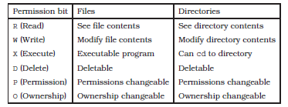
Operating System

Slide 44
Operating System
Access control lists, or Access control entries are set and checked with either the Windows Explorer program (File/Properties/Security/Permissions menu) or the cacls command.
This command works in more or less the same way as the POSIX setfacl command, but with different switches.
Eg: hybrid> CACLS testfile
  C:\home\mark\testfile BUILTIN\Administrators:F
  Everyone:C
  MT AUTHORITY\SYSTEM:F
  hybrid> CACLS testfile /G ds:F
  Are you sure(Y/N)?
  hybrid> CACLS testfile
  C:\home\mark\testfile HYBRID\ds:F

Slide 45
Operating System
The result :-
  hybrid> CACLS testfile /E /G mark:R
  {\var wait for 30 seconds}
  Are you sure(Y/N)?
  hybrid> CACLS testfile
  C:\home\mark\testfile HYBRID\ds:F
  HYBRID\mark:R

Slide 46
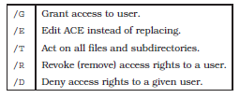
Operating System

Slide 47
Network Filesystem Model
Unix and Windows have two of the most prevalent filesystem interfaces, apart from DOS itself (which has only a trivial interface), but they are both stunted in their development.
Network File System (NFS) for Unix-like operating systems developed by sun-microsystems.
This is a distributed filesystem, for mainly local area networks.
Other filesystems that are gaining in popularity include the Andrew File System (AFS),

Slide 48
Unix and Windows sharing
Filesystems can be shared across a network by any of the methods we have discussed above.
We can briefly note here the correspondence of commands and methods for achieving network sharing.
Unix-like hosts use NFS to share filesystems, by running the daemons (e.g. rpc.mountd and rpc.nfsd).
Filesystems are made available for sharing by adding them to the file /etc/exports, on most systems, or confusingly to /etc/dfs/dfstab on SVR4 based Unix.

Slide 49
Windows filesystems on a server are shared, either using the GUI, or by executing the command : -
  net share alias=F:\filetree
On the client side, the file tree can then be ‘mounted’ by executing the command
  net use X: \\serverhost\alias
This attaches the remote file tree, referenced by the alias, to Windows drive
  X:. One of the logistical difficulties with the Windows drive model is that drive
Drive associations can be made to persist by adding a flag
  net use X: \\serverhost\alias /persistent:yes
to the mount command

Slide 50
Process Job Control
  The Unix process model
Unix starts new processes by copying old ones. Users start processes from a shell command line interface program or by clicking on icons in a window manager.
Every Unix process has a process ID (PID) which can be used to refer to it, suspend it or kill it entirely.
A background process is started from a shell using the special character & at the end of the command line.
  find / -name ’*lib*’ -print >& output &
Processes can be stopped and started, or killed once and for all. The kill command does this and more.

Slide 51
Process Job Control
Example
kill -15 127
kill 127
kill -9 127

Slide 52
Prosess Job Control
The Windows process model
Like Unix, processes under Windows/NT can live in the foreground or in the background, though unlike Unix, Windows does not fork processes by replicating
existing ones. A background process can be started with
  start /B
to kill the process it is necessary to purchase the Resource kit which contains a kill command.

Slide 53
Networks
The network is the largest physical appendage to our computer systems, but it is also the least conspicuous, often hidden behind walls and in locked switching rooms, or passing invisibly through us as electromagnetic radiation.
A network is a number of pathways for communication between two or more hosts.
Networking is increasingly important, as computers are used more and more as devices for media access rather than for computation.
Networking raises issues for system management at many levels,

Slide 54
The OSI Model
The International Standards Organization (ISO) has defined a model for describing communications across a network, called the OSI model, for Open Systems Interconnect (reference model).
This model is a generalized abstraction of how network communication can be and is implemented.
The model does not fit every network technology perfectly, but it is widely used to discuss and refer to the layers of technology involved in networking,

Slide 55
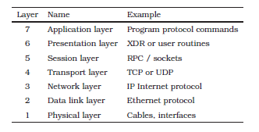
OSI Model

Slide 56
OSI Model
1. Physical layer. This is the sending a signal along a wire, amplifying it if it gets weak, removing noise etc. If the type of cable changes (we might want to reflect signals off a satellite or use fiber optics) we need to convert one kind of signal into another. Each type of transmission might have its own accepted ways of sending data (i.e. protocols).
2. Data link layer. This is a layer of checking which makes sure that what was sent from one end of a cable to the other actually arrived. This is sometimes called handshaking. The Ethernet protocol is layer 2, as is Token Ring. This level is labelled by Media Access Control (MAC) addresses.

Slide 57
Operating System
3. Network layer. This is the layer of software which recognizes structure in the network. It establishes global identity and handles the delivery of data by manipulating the physical layer. The network layer needs to know something about addresses – i.e. where the data are going, since data might flow along many cables and connections to arrive where they are going. Layer 3 is the layer at which IP addresses enter.
4. Transport layer. We shall concentrate on this layer for much of what follows. The transport layer builds ‘packets’ or ‘datagrams’ so that the network layer knows what is data and how to get the data to their destination. Because many machines could be talking on the same network all at the same time, data are broken up into short ‘bursts

Slide 58
OSI Model
’. Only one machine can talk over a cable at a time so we must have sharing. It is easy to share if the signals are sent in short bursts. This is analogous to the sharing of CPU time by use of time-slices. TCP and UDP protocols are encoded at this layer.
5. Session layer. This is the part of a host’s operating system which helps a user program to set up a connection. This is typically done with sockets or the RPC.
6. Presentation layer. How are the data to be sent by the sender and interpreted by the receiver, so that there is no doubt about their contents? This is the role played by the external data representation (XDR) in the RPC system.
7. Application layer. The program which wants to send data has its own protocol layer, typically a command language encoding (e.g. GET, PUT in FTP or HTTP).

Slide 59
Network
Cables and interface technologies
• Bus/Ethernet approach: Ethernet technology was developed by Xerox, Intel and DEC in 1976, at the Palo Alto Research Center (PARC) [103].
Token Ring/FDDI approach: In the token ring approach [253], hosts are coupled to hubs or nodes each of which has two network interfaces and the hosts are connected in a uni-directional ring.
Frame Relay is an alternative layer 2 packet-switching protocol for connecting devices on a Wide Area Network (WAN) or backbone. It is used for point-topoint connections, but is capable of basic switching, like ATM, so it can create virtual point-to-point circuits.

Slide 60
Network
ATM, Asynchronous Transfer Mode technology [23], is a high capacity, deterministic, transmission technology developed by telephone companies in order to exploit existing copper telephone networks.

Slide 61
Network
Connectivity
Network cables are joined together by hardware which makes sure that messages are transmitted from cable to segment in the right direction to reach their destinations.
A host which is coupled to several network segments and which forwards data from one network to another is called a router.
Routers not only forward data but they prevent the spread of network messages which other network segments do not need to know about.

Slide 62
Network
A bridge is a hardware device which acts like a filter on busy networks.
A bridge works like a ‘mini-router’ and separates two segments of the same cable.
A bridge knows which incoming cables do not offer a destination address and prevents traffic from spreading to this part of a cable. A bridge is used to isolate traffic on busy sections of a network or conversely to splice networks together. It is a primitive kind of switch.

Slide 63
Network
A repeater is an amplifier that strengthens the network signal over long stretches of cable.
A multi-port repeater also called a hub does the same thing and also splits one cable into N sub-cables for convenience.
Hubs are common in twisted pair networks where it is necessary to fan a cable out into a star pattern from the hub to send one cable to each host.

Slide 64
Network
A switch is a hub which can direct a message from one host cable directly to the intended host by routing the signal directly.
The advantage with this is that other machines do not have to see the traffic between two hosts.
Each pair of hosts has a virtual private cable. Switched networks are not immune to spies, net-sniffing or network listening devices, but they make it more difficult for the casual browser to see traffic that does not concern them.
A switch performs many of the tasks of a router and vice versa. The difference is that a switch works at layer 2 of the OSI model (i.e. with MAC addresses), whereas a router works at layer 3 (IP addresses).
A switch cannot route data on a world-wide basis.

Slide 65
LANs, WANs and VLANs
VLANs (virtual LANs) are a step towards selective filtering at the switch level.
They allow switches to protect swamped routers by offering different groups, or channels for related nodes.
LAN ???
WAN ??

Slide 66
Protocols and encapsulation
Information transactions take place by agreed standards or protocols.
Protocols exist to make sure that transmitted data are understood by the receiver in the way that the sender intended.
protocols are required to make sure that data are understood, not only by the receiver, but by all the network hardware which carry them between source and destination.
The data are wrapped up in envelope information which contains the address of the destination.
Each transmission layer in the protocol stack (protocol hierarchy) is prefixed with some header information which contains the destination address and other data which identify it.

Slide 67

LANs, WANs and VLANs

Slide 68
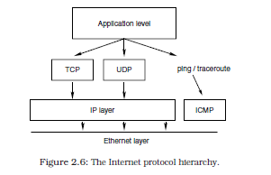
LANs, WANs and VLANs

Slide 69
LANs, WANs and VLANs
The transmission control protocol (TCP) is for reliable connection-oriented transfer.
The user datagram protocol (UDP) is a rather cheaper connection-less service and the Internet control message protocol (ICMP) is used to transmit error messages and routing information for TCP/IP.
These protocols have an address structure which is hierarchical and routable, which means that IP addresses can find their way from any host in the world to any other so long as they are connected.
The Ethernet protocol does not know much more about the world than the cable it is attached to.

Slide 70
LANs, WANs and VLANs
Windows supports at least three network protocols, running on top of Ethernet.
  • NETBEUI: NETBIOS Extended User Interface, Microsoft’s own network protocol.This was designed for small networks and is not routable. It has a maximum limit of 20 simultaneous users and is thus hardly usable.
  • NWLink/IPX: Novell/Xerox’s IPX/SPX protocol suite. Routable. Maximum limit of 400 simultaneous users.
  TCP/IP: Standard Internet protocols. The default for Windows-like and Unixlike systems. Novell Netware and Apple MacIntosh systems also support TCP/IP. There is no in-built limit to the number of simultaneous users.

Slide 71
Data Format
Operating systems (actually the hardware they run on) fall into two categories known as big endian and little endian. The names refer to the byte-order of numerical representations.
The names indicate how large integers (which require say 32 bits or more) are stored in memory.
Little endian systems store the least significant byte first,
Big endian systems store the most significant byte first.
For example, the representation of the number 34,677,374 has either of the forms shown in next figure

Slide 72
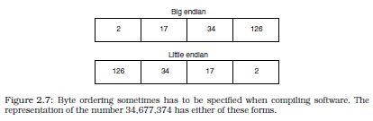

Slide 73
IPv4 networks
Every network interface on the Internet needs to have a unique number which is called its address.
IP addresses are organized hierarchically so that they can be searched for by router networks. Without such a structure, it would be impossible to find a host unless it were part of the same cable segment. At present the Internet protocol is at version 4 and this address consists of four bytes, or 32 bits.
In the future this will be extended, in a new version of the Internet protocol IPv6, to allow more IP addresses since we are rapidly using up the available addresses.
The addresses will also be structured differently. The form of an IP address in IPv4 is
  aaa.bbb.ccc.mmm

Slide 74
Networks were grouped historically into three classes called class A, class B and class C networks, in order to simplify traffic
Class D and E networks are also now defined, but these are not used for regular traffic.
The difference between class A, B and C networks lies in which bits of the IP addresses refer to the network itself and which bits refer to actual hosts within a network.

Slide 75
Class A legacy networks
IP addresses from 1.0.0.0 to 127.255.255.255 are class A networks.
Originally only 11.0.0.0 to 126.255.255.255 were used, but this is likely to change as the need for IPv4 address space becomes more desperate.
In a class A network, the first byte is a network part and the last three bytes are the host address. This allows 126 possible networks (since network 127 is reserved for the loopback service).
The number of hosts per class A network is 2563 minus reserved host addresses on the network.

Slide 76
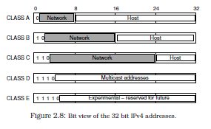

Slide 77
Class B legacy networks
IP addresses from 128.0.0.0 to 191.255.0.0 are class B networks.
There are 16,384 such networks. The first two bytes are the network part and the last two bytes are the host part.
This gives a maximum of 2562 minus reserved host addresses, or 65,534 hosts per network.
Default net mask is 255.255.0.0

Slide 78
LANs, WANs and VLANs
Class C legacy networks
IP addresses from 192.0.0.0 to 223.255.255.0 are class C networks.
There are 2,097,152 such networks. Here the first three bytes are network addresses and the last byte is the host part.
This gives a maximum of 254 hosts per network.
The default subnet mask is 255.255.255.0

Slide 79
Class D (multicast) addresses
Multicast networks form what is called the MBONE, or multicast backbone.
These include addresses from 224.0.0.0 to 239.255.255.0.
These addresses are not normally used for sending data to individual hosts, but rather for routing data to multiple destinations.
Multicast is like a restricted broadcast. Hosts can ‘tune in’ to multicast channels by subscribing to MBONE services.

Slide 80
Class E (Experimental) addresses
Addresses 240.0.0.0 to 255.255.255.255 are unused and are considered experimental, though this may change as IPv4 addresses are depleted.
Other addresses
Some IP addresses are reserved for a special purpose. They do not necessarily refer to hosts or networks.
  0.0.0.0 Default route
  0.*.*.* Not used
  127.0.0.1 Loopback address
  127.*.*.* Loopback network
  *.*.*.0 Network addresses (or old broadcast)
  *.*.*.255 Broadcast addresses
  *.*.*.1 Router or gateway (conventionally)
  224.*.*.* Multicast addresses

Slide 81
RFC 1918 defines private addresses that are not routed
  10.0.0.0 - 10.255.255.255 (10/8 prefix)
  172.16.0.0 - 172.31.255.255 (172.16/12 prefix)
  192.168.0.0 - 192.168.255.255 (192.168/16 prefix)
and as of July 2001
  169.254.0.0 - 169.254.255.255 (192.254/16 prefix)
The network
  192.0.2.0 - 192.0.2.255

Slide 82
The default route is a default destination for outgoing packets on a subnet and is usually made equal to the router address.
The loopback address is an address which every host uses to refer to itself internally. It points straight back to the host. It is a kind of internal pseudoaddress which allows programs to use network protocols to address local services without anything being transmitted on an actual network.
The zeroth address of any network is reserved to mean the network itself, and the 255th (or on older networks sometimes the zeroth) is used for the broadcast address. Some Internet addresses are reserved for a special purpose.
These include network addresses (usually xxx.yyy.zzz.0), broadcast addresses (usually xxx.yyy.zzz.255, but in older networks it was xxx.yyy.zzz.0) and multicast addresses (usually 224.xxx.yyy.zzz).

Slide 83
Subnet & Broadcast
Netmask
Broadcast
Interface settings
  The IP address of a host is set in the network interface.
  The Unix command ifconfig (interface-configuration) or the Windows command ipconfig are used to set this.
Default route
  Each host must define a default route which is a destination to which outgoing packets will be sent for processing when they do not belong to the subnet.
  This is the address of the router or gateway on the same network segment. It is set by a command like this:
    route add default my-gateway-address 1

Slide 84
The default route can be checked using the netstat -r command.
The result should just be a few lines like this:
Kernel IP routing table
Destination Gateway Genmask Flags Metric Ref Use Iface
localnet * 255.255.255.0 U 0 0 932 eth0
Loopback * 255.0.0.0 U 0 0 38 lo
default my-gw 0.0.0.0 UG 1 0 1534 eth0

Slide 85
ARP/RARP
The Address Resolution Protocol (ARP) is a name service directory for translating from IP address to hardware, Media Access Control (MAC) address (e.g. Ethernet address).
The ARP service is mirrored by a reverse lookup ARP service (RARP). RARP takes a hardware address and turns it into an IP address.

Slide 86
Address space in IPv4
As we have seen, the current implementation of the Internet protocol has a number of problems.
The model of classed Internet addresses was connected to the design
of early routing protocols. This has proved to be a poor design decision, leading to a sparse usage of the available addresses.
It is straightforward to calculate that, because of the structure of the IP addresses, divided into class A, B and C networks, something under two percent of the possible addresses can actually be used in practice.
A survey from Unix Review in March 1998 showed that, of the total numbers of addresses, these are already allocated:
Max possible Percent allocated
Class A 127 100%
Class B 16382 62%
Class C 2097150 36%

Slide 87
CIDR was introduced as an interim measure to combat the problems of IP address allocation as well as that of routing table overflow.
It is also the strategy of choice for IPv6 addressing. The name refers to inter-domain routing because it provides not only an addressing solution, but also an improved model for routing packets, by defining routing domains (distinct from logical domains of the Domain Name Service).
The IPv4 address space has two problems:
  It is running out of address space, because many addresses are bound up in classes that make them unusable, with the class A,B,C scheme of IP addresses.
  Global routing tables are becoming too large, making routing slow and memory intensive.

Slide 88
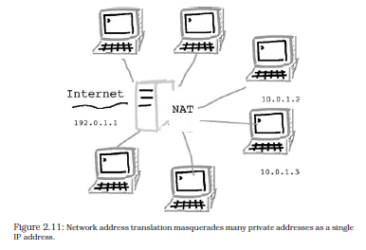
NAT

Slide 89
QUIZ2
What is meant by a securable operating system?
Name and describe the layers of the OSI model.
What are the following?: i) repeater, ii) hub, iii) switch, iv) bridge, v) router.
Explain what an access control list is. Compare the functionality of the Unix file permission model with that of access control lists. Given that ACLs take up space and have many entries, what problems do you foresee in administering file security using ACLs?
Explain why the following are invalid IPv4 host addresses:
(a) 10.1.0.0
(b) 10.1.0.255
(c) 0.12.16.89
(d) 255.9.56.45
(e) 192.34.255.255

Slide 90
NAT
to provide a ‘quick fix’ for organizations that required only partial connectivity,
In NAT, a network is represented to the outside world by a single official IP address; it shields the remainder of its networked machines on a private network that (hopefully) uses non-routable addresses (usually 10.x.x.x).
When one of these hosts on the private network attempts to contact an address on the Internet, the Network Address Translator creates the illusion that the request comes from the single representative address.
The return data are, in turn, routed back to the particular host ‘as if by magic’.
NAT makes associations of this form:
  (private IP, private port) <-> (public IP, public port)

